Slide 1

BIKE SHARING DEMAND ANALYSIS USING EXCEL
Presented By:
Rishi Yadav
Position:
Data Science Intern
Organization:
Nexthikes IT Solutions
Project:
Bike Sharing Demand Analysis

Slide 2
PROJECT OVERVIEW
Analyze bike-sharing Demand Identify Rental Pattern in Total Bike Rentals.
Study Time Base Demand Analyze How Rentals Change by Hour, Time group, Weekday and Working Days.
Analyze Weather Impact Examine the relationship between temperature, humidity, wind speed and weather conditions and bike rentals.
Compare User Types Analyze The Rental Behavior of Casual and Registered Users.
Create Build interactive dashboard Create KPI’S , PivotTables, Slicers and Timeline for Interactive Analysis.
Apply Advanced Analysis Use Descriptive Statistics, Correlation Analysis, forecasting and anomaly detection to Generate Useful Business Insights.
Support Business Planning Use the identified patterns to support demand planning, resource allocation and operational decisions.
Tools Used : Excel | Power Query | PivotTables | Pivot Charts | Dashboard | Forecasting | Anomaly Detection.

Slide 3
END-TO-END EXCEL WORKFLOW
Tools Used: Excel | Power Query | Data Cleaning | Data Validation.
Dataset_1: Bike-sharing rental and time-related records.
Dataset_2: Weather data, including temperature, humidity, and wind speed.
Dataset_3: Additional bike-sharing records for further analysis.
Dataset_1 + Dataset_2 → Merge Queries.
Dataset_3 → Append/Combine → Final Dataset.
Data cleaning : Handled missing values and duplicates.
Data Type Correction : Corrected Date, Time, Number and Text data types.
Final Dataset : Prepared for PivotTables, dashboards, forecasting, and anomaly detection.

Slide 4
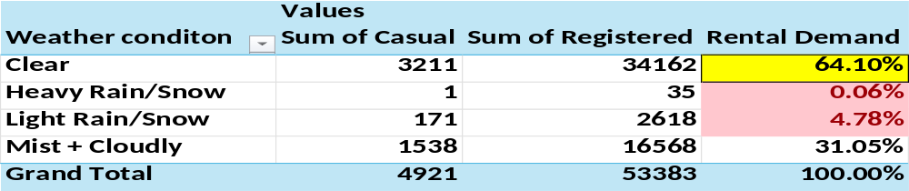
PIVOT TABLE
PivotTables: Summarized rental demand based on Temp, Atemp, Humidity, Windspeed, weather, time, date, and user type.
Weather Condition Analysis.
Clear weather accounted for the highest rental share (64.10%), followed by Mist + Cloudy (31.05%). Overall, rentals were concentrated in these conditions, with Registered users contributing more than Casual users.

Slide 5
Date-wise Rental Demand
Rental demand fluctuated from 1 January to 14 February 2011, peaking on 25 January (1,985 rentals; 3.40%), followed by 20 January (1,927; 3.31%) and 11 February (1,746; 2.99%). Registered users contributed the majority of rentals.

Slide 6
Hour Wise Demand Rental
Overall, rental demand peaked at 5 PM (10.58%), followed by 8 AM (9.24%) and 6 PM (9.06%). Registered users peaked at 5 PM (5,774 rentals), while casual users peaked at 3 PM (536 rentals). Demand was lowest at 4 AM (0.12%) and 3 AM (0.26%).

Slide 7
Temperature wise Demand
Highest rental demand occurred at normalized temperature 0.20 (13.59%), with relatively high demand between 0.16 and 0.24. Overall, moderate temperatures were associated with higher bike rental demand.

Slide 8
Atemp Wise Demand
Highest rental demand occurred at normalized Atemp 0.2273 (12.02%), with relatively high demand between 0.1818 and 0.2273. Overall, moderate apparent temperatures were associated with higher bike rental activity.

Slide 9
Humidity Wise Demand
Highest rental demand occurred at humidity 0.47 (5.51%). Demand fluctuated across humidity levels, showing no consistent pattern compared with temperature-related demand.

Slide 10
Windspeed wise Demand
Rental demand was highest at wind speed 0 (13.46%), indicating that lower wind speeds were generally associated with higher bike rental activity, despite some fluctuations.

Slide 11
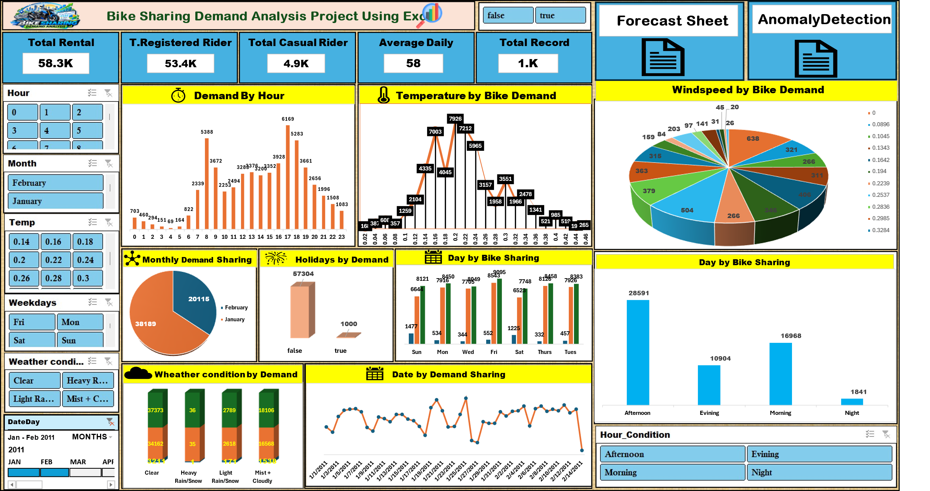
Interactive Dashboard

Slide 12
Dashboard Overview
KPIs: Total Rentals (58.3K), Registered Riders (53.4K), Casual Riders (4.9K), Average Daily Rentals (58), and Total Records (1K).
Demand Analysis: Charts display rental trends by hour, temperature, month, holidays, weekdays, weather conditions, and dates.
Interactive Filters: Slicers and Timeline allow dynamic filtering by hour, month, temperature, weekday, weather, and date.
Forecasting & Anomaly Detection: Clicking the respective sections opens their Excel sheets for detailed forecasting and anomaly analysis.
Business Insights: The dashboard helps identify rental patterns, peak-demand periods, and unusual demand changes for better business planning.

Slide 13
Descriptive Statistics
Temperature and Atemp values were relatively stable.
Humidity and Windspeed showed moderate variation.
Casual rentals showed strong right-skewness (3.41).
Registered rentals were also right-skewed (1.30).
Total rentals: Mean 58.3, Median 49, SD 50.99.
Overall, rental demand varied considerably, with occasional high-demand observations.

Slide 14
Correlation
Temp & Atemp: Very strong positive correlation (0.918).
Temp & Count: Weak positive correlation (0.234).
Atemp & Count: Weak positive correlation (0.192).
Humidity & Count: Weak negative correlation (-0.256).
Windspeed & Count: Very weak positive correlation (0.105).
Overall: Weather variables showed mostly weak correlations with rental demand.

Slide 15
Forecasting
Historical
Future Forecast
01 Jan To 14 Feb – 2011
Actual rental data
Demand High fluctuations
Peak = 1,985
Actual observations.
15 Feb TO 15 Mar-2011
Estimated rental demand
Relatively stable pattern
End forecast = 1,506
Model-based estimates.

Slide 16
Fore Casting Chart

Slide 17
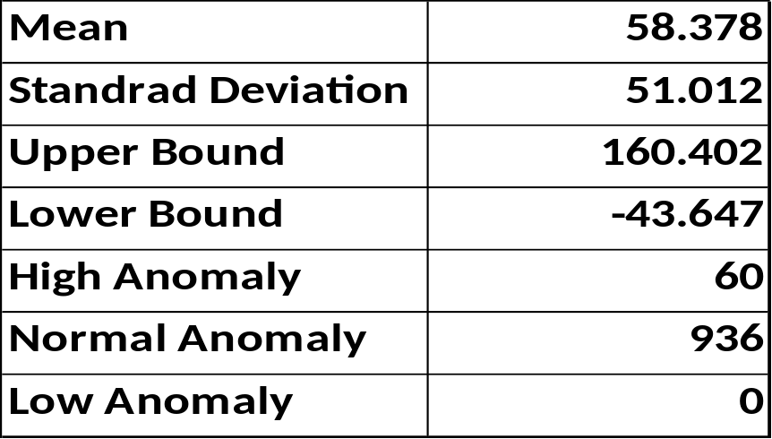
Anomaly Detection
Anomaly detection identified 60 high-anomaly observations out of 996 total observations, while 936 observations were classified as normal. No low anomalies were detected because the calculated lower bound (-43.647) was below the possible rental range. High anomalies represent unusually high rental demand and can be investigated for potential demand spikes.

Slide 18
Anomaly Detection

Slide 19
Decision Making / Recommendations
Customer Management
Prioritize registered users and encourage casual users through membership offers.
Future Demand Planning
Use forecasting to plan bike availability and resources during peak-demand hours.
Anomaly Management
Investigate the 60 high-anomaly observations to understand unusual demand spikes and prepare for similar situations.
Continuous Monitoring
Use the interactive dashboard, KPIs, Slicers, and Timeline to monitor demand and update analysis with new data.
Decision Making
Maintain more bikes during peak hours, use low-demand periods for maintenance and redistribution, and use weather, forecasting, and demand patterns to support better business decisions.

Slide 20
Business Insights
Peak Demand: 8 AM and 5–6 PM
Registered users: Major Contributor
Moderate Temperature: Higher Demand
Low Wind speed: Comparatively Higher Demand
60 High-Demand Anomalies: Investigate Demand Spikes

Slide 21

Thank You

